Slide 1
CHAPTER 4: Signal Assignment Statements of VHDL

Slide 2
Syllabus
Week | Content | Notes
1 | Chapter 0: Course Introduction (1) Chapter 1: Introduction to Digital Design (2)
2 | Chapter 2: Overview of HDL (3)
3 | Chapter 3: Basic Language Constructs of VHDL (3)
4, 5 | Chapter 4: Signal Assignment Statements of VHDL (6)
6 | Chapter 5: Combinational Logic Circuit Design (3)
7 | Midterm Exam (2)
8 | Chapter 6: Sequential Logic Circuit Design (3)
9, 10 | Chapter 7: Finite State Machine (FSM) Principle (6)

Slide 3
Content
Combinational vs. Sequential Circuits
Concurrent Signal Assignment Statement
Sequential Signal Assignment Statement

Slide 4
1. Combinational vs. Sequential Circuits
A digital circuit can be broadly classified as
Combinational
Sequential
A combinational circuit has:
No internal memory, clock signal or state
Its output is a function of inputs only
A sequential circuit has
Has an internal state
Its output is a function of inputs as well as the internal state.

Slide 5
2. Concurrent Signal Assignment Statement
Concurrent signal assignment statements are simple, yet powerful VHDL statement.
Mapping between the assignment statement and hardware components is clearly.
We can easily visualize the conceptual diagram of the VHDL description.
This help us to develop a more efficient design.

Slide 6
2. Concurrent Signal Assignment Statement
Simple Signal Assignment Statement
Conditional Signal Assignment Statement
Selected Signal Assignment Statement
Comparison

Slide 7
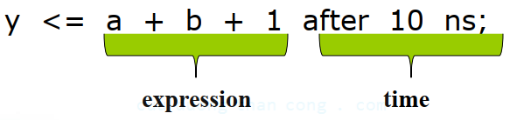
2.1. Simple Signal Assignment Statement
Syntax:
The projected_waveform clause consists of two kinds of specifications:
The expression of a new value for the signal
The time when the new value takes place
Example:

Slide 8
2.1. Simple Signal Assignment Statement
The time aspect of projected_waveform normally corresponds to the internal propagation delay to complete the computation of the expression.
Since the propagation delay depends on
The components
Device technology
Routing, fabrication process
Operation environment
It is impossible to synthesis a circuit with an exact amount of delay.
Therefore, for synthesis, explicit timing information is not specified in VHDL code.

Slide 9
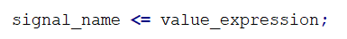
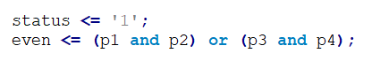
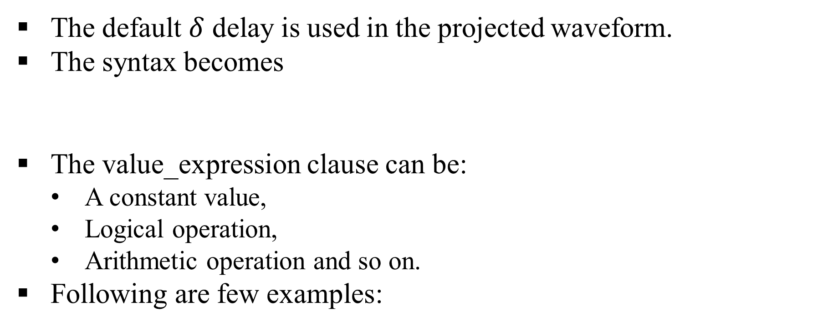
2.1. Simple Signal Assignment Statement
The default $δ$ delay is used in the projected waveform.
The syntax becomes
The value_expression clause can be:
A constant value,
Logical operation,
Arithmetic operation and so on.
Following are few examples:

Slide 10
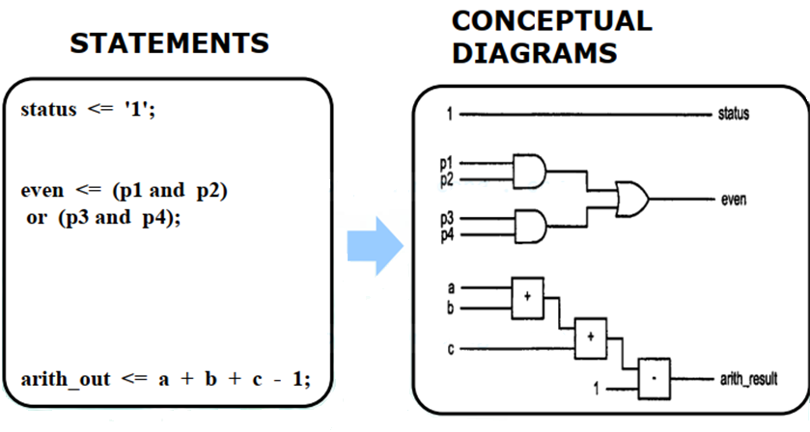
2.1. Simple Signal Assignment Statement

Slide 11
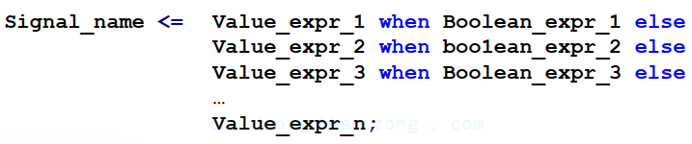
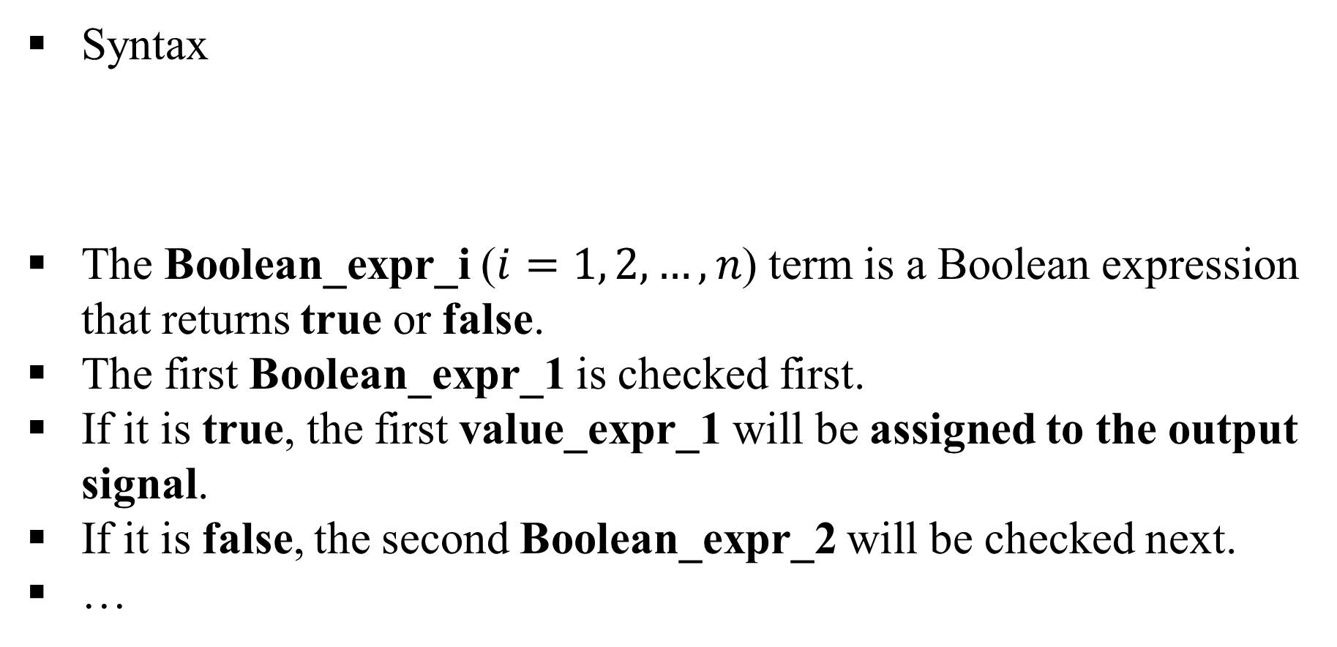
2.2. Conditional Signal Assignment Statement
Syntax
The Boolean_expr_i ($i=1, 2,…, n$) term is a Boolean expression that returns true or false.
The first Boolean_expr_1 is checked first.
If it is true, the first value_expr_1 will be assigned to the output signal.
If it is false, the second Boolean_expr_2 will be checked next.
…

Slide 12
2.2. Conditional Signal Assignment Statement
This process continues until all Boolean expression are checked.
The last value expression, value_expr_n, will be assigned to the signal if none of the Boolean expressions is true.
Several simple examples to illustrate the use of conditional signal assignment statements.
The circuits includes a
Multiplexer
Decoder
Priority encoder
Simple arithmetic logic unit (ALU)

Slide 13
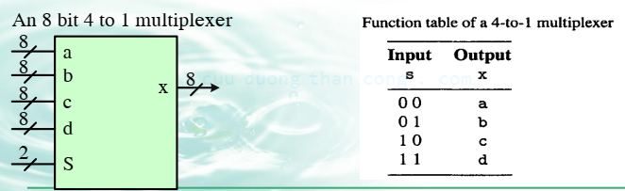
2.2.1. Example: Multiplexer
A multiplexer is essentially a virtual switch that routes a selected input signal to the output.
The function table of an 8-bit 4-to-1 multiplexer is shown in Table:
Listing 4-to-1 multiplexer based on a conditional signal assignment statement.

Slide 14
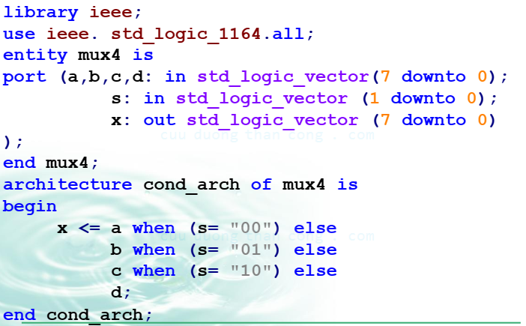
2.2.1. Example: Multiplexer

Slide 15
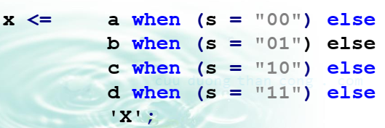
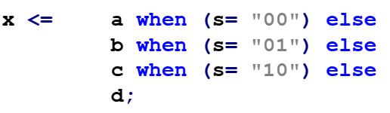
2.2.1. Example: Multiplexer
At first glance, it seems that s is implied to be “11” when the first three Boolean expressions are false, and thus d is assigned to x.
However, there are 9 possible values in std_logic data type and, for the 2-bit s signal, there are 81 (i.e., 9*9) possible combinations, including the expected “00”, “01”, “10” and “11” as well as the meta-value combinations, such as “0Z”, “UX”, “0-” and so on.

Slide 16
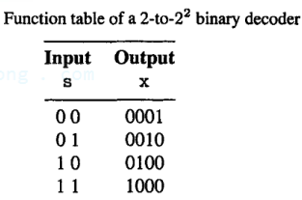
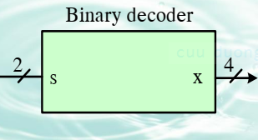
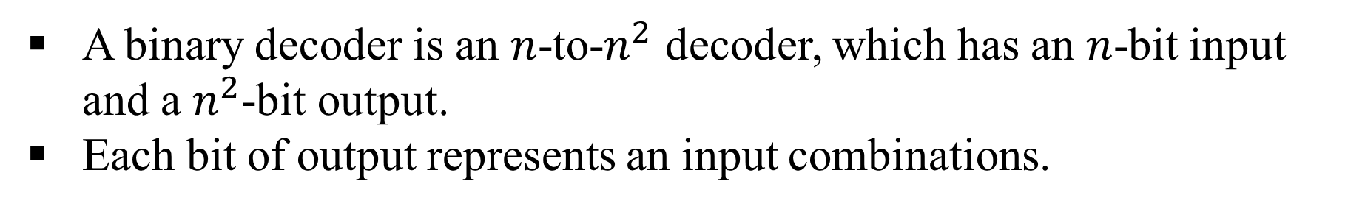
2.2.2. Example: Binary Decoder
A binary decoder is an $n$-to-$n^{2}$ decoder, which has an $n$-bit input and a $n^{2}$-bit output.
Each bit of output represents an input combinations.

Slide 17
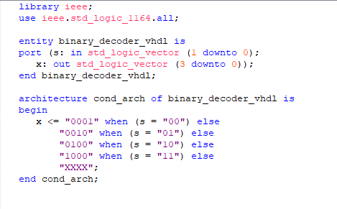
2.2.2. Example: Binary Decoder

Slide 18
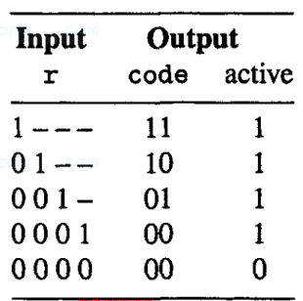
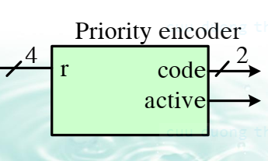
2.2.3. Example: Priority Encoder
A priority encoder checks the input requests and generates the code of the request with highest priority.

Slide 19
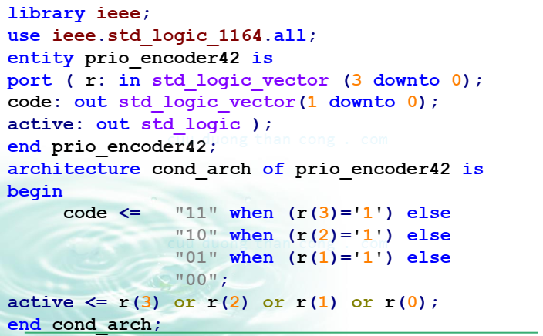
2.2.3. Example: Priority Encoder

Slide 20
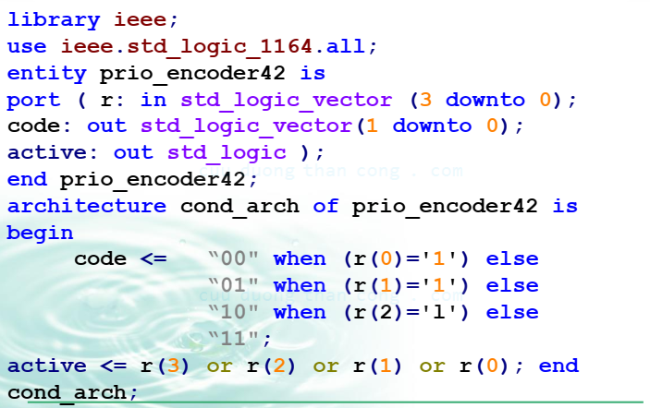
2.2.3. Example: Priority Encoder

Slide 21
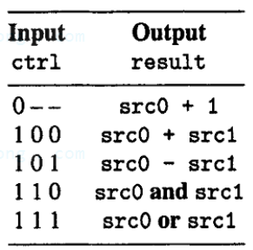
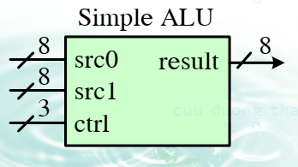
2.2.4. Example: ALU
An ALU performs a set of arithmetic and logical operations. The function table of a simple ALU is shown as

Slide 22
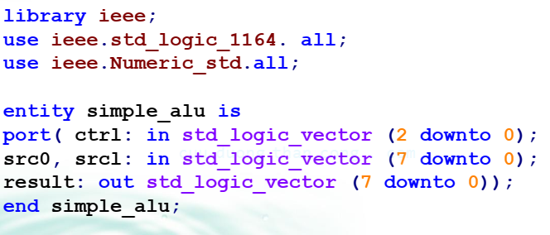
2.2.4. Example: ALU

Slide 23
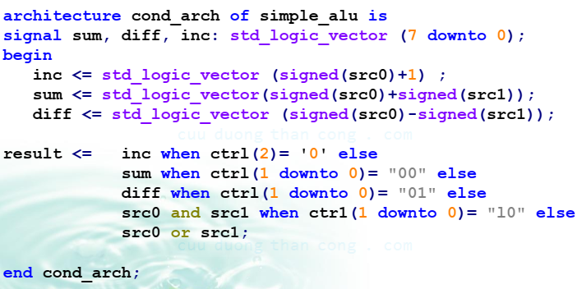
2.2.4. Example: ALU

Slide 24
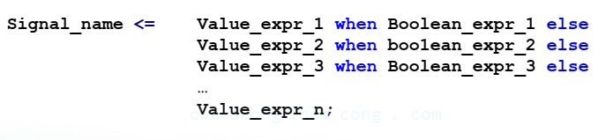
2.3. Conceptual Implementation
Recall that the syntax of the simplified
Constructing the conditional signal assignment statement requires three groups of hardware:
Value expression circuits
Boolean expression circuits
Priority routing network

Slide 25
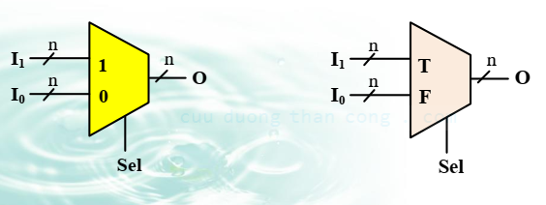
2.3. Conceptual Implementation
A priority network can be implemented by a sequence of 2-to-1 multiplexers.
To better illustrate the conceptual implementation, we utilize an “abstract multiplexer”.

Slide 26
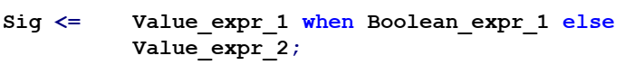
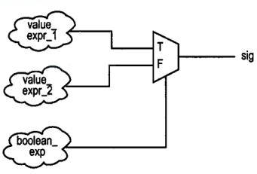
2.3. Conceptual Implementation
Let us first consider a simple conditional signal assignment statement that has only one when clause:
The conceptual realization of this statement is shown:

Slide 27
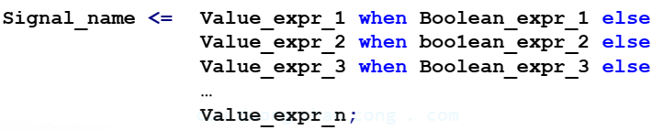
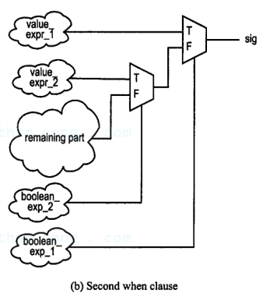
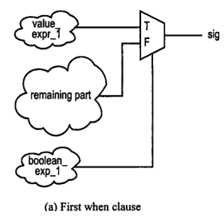
2.3. Conceptual Implementation
Consider a statement with three when clauses
The construction sequence is shown as

Slide 28
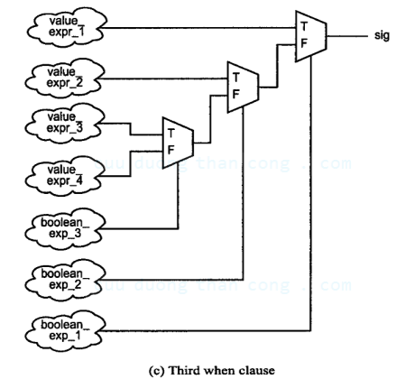
2.3. Conceptual Implementation

Slide 29
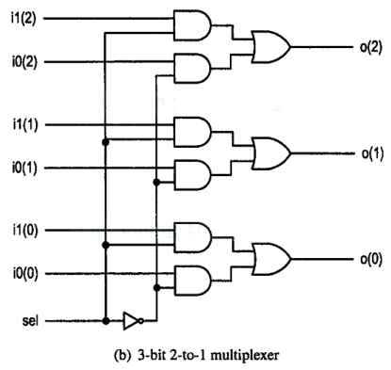
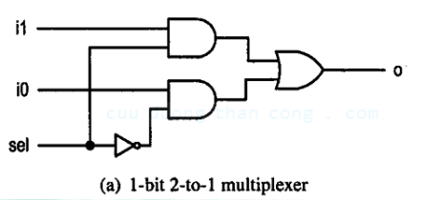
2.3. Conceptual Implementation
Implementation of a multiplexer

Slide 30
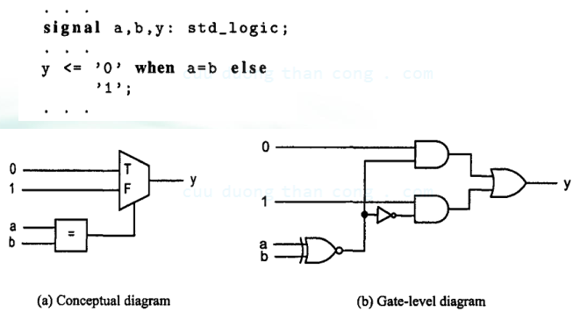
2.3. Conceptual Implementation
Consider the example of the comparison VHDL program

Slide 31
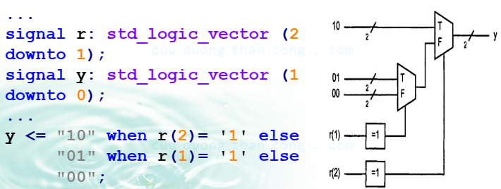
2.3. Conceptual Implementation
Consider the example of the 2-bit comparison VHDL program

Slide 32
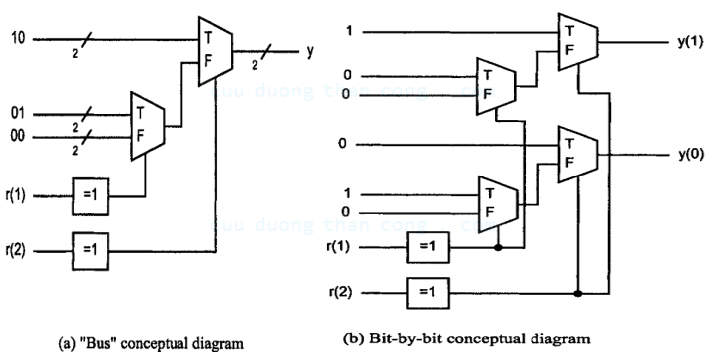
2.3. Conceptual Implementation
Consider the following VHDL segment:

Slide 33
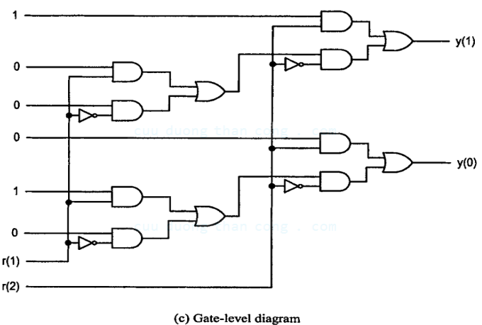
2.3. Conceptual Implementation

Slide 34
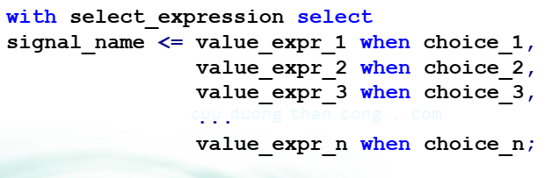
2.4. Selected Signal Assignment Statement
Syntax
A choice (i.e., choice_i) must be a valid value or a set of valid values of select_expression.

Slide 35
2.4. Selected Signal Assignment Statement
All possible values of select_expression must be covered by one and only one choice.
The reversed word, others, can be used in the last choice (i.e., choice_n) to represent all the previously unused values.
We use the same:
Multiplexer
Binary decoder
Priority encoder
ALU circuit
to illustrate use of the selected signal assignment statement.

Slide 36
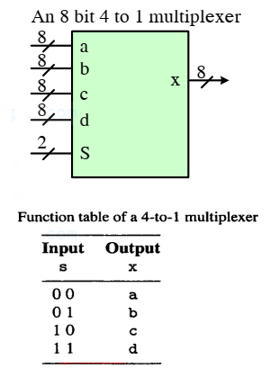
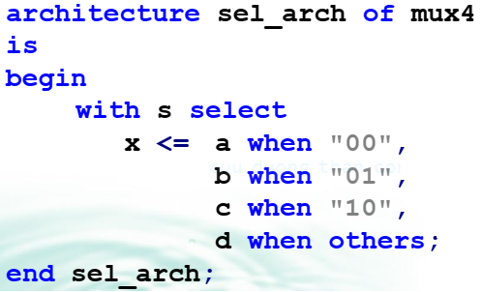
2.4.1. Example: Multiplexer

Slide 37
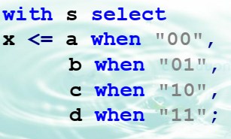
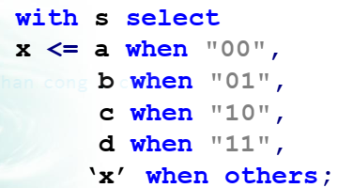
2.4.1. Example: Multiplexer
We cannot simply list the last choice as “11”:
Some synthesis software may accept the following form:

Slide 38
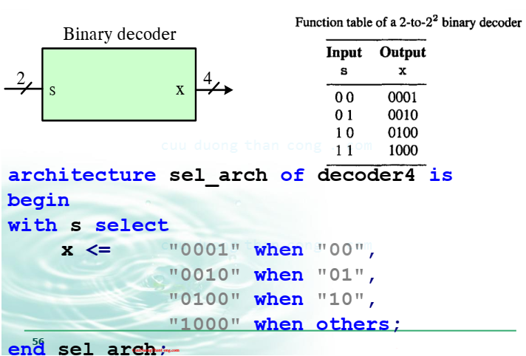
2.4.2. Example: Binary Decoder

Slide 39
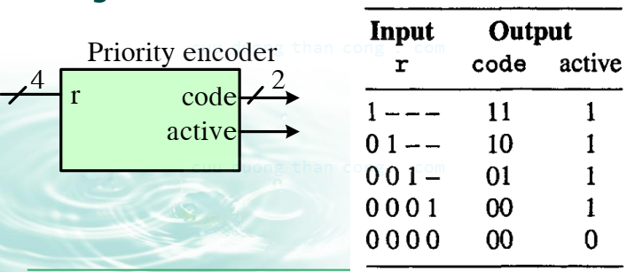
2.4.3. Example: Priority Encoder
Listing 4-to-2 priority encoder based on a selected signal assignment statement.

Slide 40
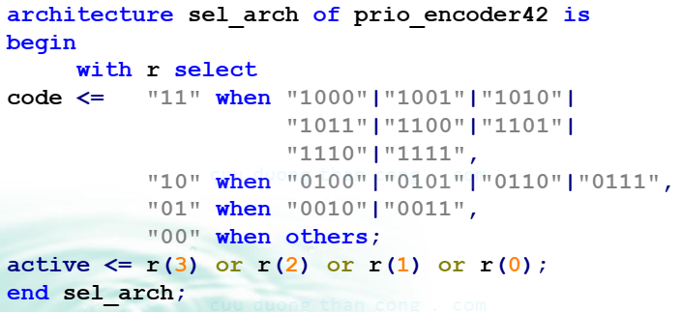
2.4.3. Example: Priority Encoder

Slide 41
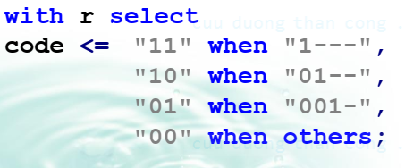

2.4.3. Example: Priority Encoder
Intuitively, we may wish to use the ‘-’ (don’t care) value of the std_logic data type to make the code compact:
Since the ‘-’ value will never occur in the physical circuit, the “1---”, “01--” and “001-” choices will never be met and the code is the same as

Slide 42
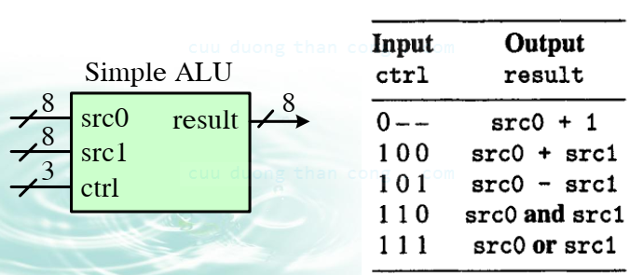
2.4.3. Example: Simple ALU
Listing simple ALU based on a selected signal assignment statement.

Slide 43
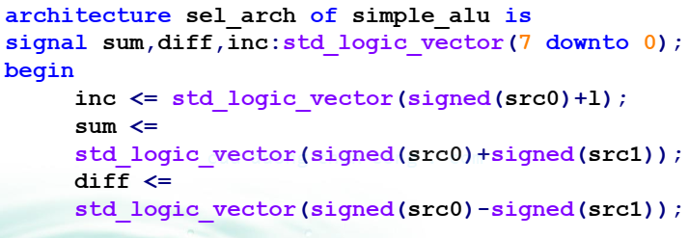
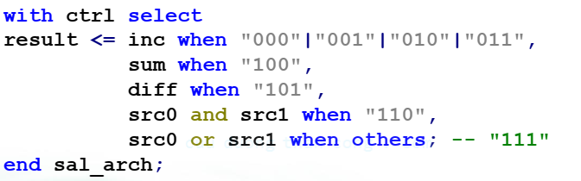
2.4.3. Example: Simple ALU

Slide 44
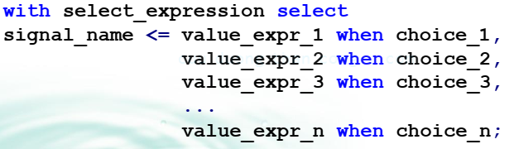

2.4.4. Conceptual Implementation
Recall that the syntax of the selected signal assignment is
For example, consider a selection signal with k+1 different possible values, c0, c1, …, ck.
The abstract multiplexer has k+1 ports, each corresponding to a value, as shown as

Slide 45
2.4.4. Conceptual Implementation
The conceptual implementation of the selected signal assignment statement involves a single abstract multiplexer and is straightforward.
Consider the following statement

Slide 46

2.4.4. Conceptual Implementation

Slide 47

2.4.4. Conceptual Implementation

Slide 48

2.4.4. Conceptual Implementation
Example 1: Consider the following VHDL segments:

Slide 49


2.4.4. Conceptual Implementation

Slide 50



2.4.4. Conceptual Implementation
Example 2: Consider the truth table corresponding VHDL segment

Slide 51

2.5. Conclusion

Slide 52

2.5. Conclusion

Slide 53
2.5. Conclusion
Avoid a closed feedback loop in a concurrent signal assignment statement.
Think of the conditional signal assignment (CSAS) and selected assignment statement (SSAS) as routing structures rather than sequential control constructs.
The CSAS infers a priority routing structure, and a larger number of when clauses leads to a long cascading chain.
The SSAS infers a multiplexing structure, and a large number of choices leads to a wide multiplexers.

Slide 54
3. Sequential Signal Assignment Statements
Sequential statements are executed in sequence.
Sequential statements are not compatible with the general concurrent execution model of VHDL.
Sequential statements have to be enclosed inside a construct known as a process.
The main purpose of sequential statements is to describe and model a circuit’s “abstract behavior”.
There is no clear mapping between sequential statements and hardware components.
Some statements and coding styles are difficult or even impossible synthesize.

Slide 55
3. Sequential Signal Assignment Statements
VHDL Process
Sequential Signal Assignment Statement
Variable Assignment Statement
IF Statement
CASE Statement
Simple For Loop Statement
Synthesis of Sequential Statement

Slide 56
3.1. VHDL Process
A process is a VHDL construct that contains a set of action to be executed sequentially.
These actions are known as sequential statements.
The process itself is a concurrent statement.
Sequential statements include a rich variety of constructs, and they can exist only inside a process.
The execution inside a process is sequential, and thus the order of the statement is important.

Slide 57
3.1. VHDL Process
A process is a VHDL construct that contains a set of action to be executed sequentially.
These actions are known as sequential statements.
The process itself is a concurrent statement.
Sequential statements include a rich variety of constructs, and they can exist only inside a process.
The execution inside a process is sequential, and thus the order of the statement is important.

Slide 58
3.1. VHDL Process
We examine the use and synthesis of the following sequential statement in this Chapter
Wait statement
Sequential signal assignment statement
Variable assignment statement
IF statement
CASE statement
Simple for loop statement
The process has two basic forms:
The first form has a sensitivity list but no wait statement inside the process.
The second form has one or more wait statement but no sensitivity list.

Slide 59

3.1. VHDL Process
The syntax of a process with a sensitivity list is

Slide 60

3.1.1. Process With A Sensitivity List
A VHDL process is activated when a signal in the sensitivity list changes its value, like a circuit responding to an input signal.
Once a process is activated, its statements will be executed sequentially until the end of process.
The process is then suspended until the next change of signal.
A simple process

Slide 61

3.1.2. Process With A Wait Statement
A process with wait statements has one or more wait statements but no sensitivity list.
The wait statement has several forms:
Wait on signals
Wait until Boolean expression;
Wait for time expression;
Example

Slide 62

3.2. SSAS
The syntax of a sequential assignment is
If the default delay $δ$ is used, the syntax becomes
Note that: the concurrent conditional and selected signal assignment statements cannot be used inside process.

Slide 63

3.2. SSAS
Inside a process, a signal can be assigned multiple times.
If all assignments are with $δ$ delays, only the last assignment takes effect.
Because the signal is not updated until the end of the process, it never assumes any “intermediate” value.

Slide 64


3.2. SSAS
For example, consider the following code segment. They are same.

Slide 65

3.3. Variable Assignment Statement
The syntax of a variable assignment statement is
There is no time dimension (i.e., no propagation delay) and the assignment takes effect immediately.

Slide 66

3.3. IF Statement
The simplified syntax of an if statement is

Slide 67

3.3. IF Statement
Example 1: Listing 4-to-1 multiplexer based in an IF statement

Slide 68

3.3. IF Statement
Example 2: Listing 2-to-4 decoder based in an IF statement

Slide 69

3.3. IF Statement
Example 3: Listing 4-to-1 priority encoder based in an IF statement

Slide 70
3.3. IF Statement
Comparison to a conditional signal assignment statement
An IF statement is somewhat like a concurrent conditional signal assignment statement.
If the sequential statements inside an IF statement consist of only the signal assignment of a single signal, as in previous examples, the two statements are equivalent.

Slide 71


3.3. IF Statement
Consider the following conditional signal assignment statement:
It can be written as

Slide 72

3.3. IF Statement
Assume that we want to find the maximum value of three signals a, b and c

Slide 73

3.3. IF Statement
We can use three conditional signal assignment statements to achieve the same task:

Slide 74


3.3. IF Statement
Using one conditional signal assignment statement
The code is shortest and is easy to understand

Slide 75

3.3. IF Statement

Slide 76

3.3. IF Statement
One way to make the code compact and clear is to assign a default value for each signal in the beginning of the process

Slide 77


3.3. IF Statement
Conceptual implementation

Slide 78


3.3. IF Statement
Conceptual implementation: An if statement is more flexible and can accommodate more than one statement in each branch

Slide 79

3.3. IF Statement
Conceptual implementation: An if statement is more flexible and can accommodate more than one statement in each branch

Slide 80

3.3. IF Statement
Conceptual implementation: An if statement is more flexible and can accommodate more than one statement in each branch

Slide 81

3.3. IF Statement
We can replace an if statement with multiple elsif branches with a sequence of simple cascading single-branched if statements.

Slide 82

3.3. CASE Statement
The simplified syntax of a case statement is

Slide 83

3.3. CASE Statement
Example 1: Listing 4-to-1 multiplexer based on a case statement

Slide 84

3.3. CASE Statement
Example 2: Listing 2-to-4 decoder based on a case statement

Slide 85



3.3. CASE Statement
Consider a selected signal assignment statement:

Slide 86

3.3. CASE Statement
Conceptual implementation: CASE statement has two outputs:

Slide 87

3.3. CASE Statement
Conceptual implementation: CASE statement has two outputs:

Slide 88

3.4. Simple FOR Loop Statement
The simplified syntax of the FOR loop statement
The FOR loop repeats the loop body of sequential statements for a fixed number of iterations.
The loop range term specifies a range of values between the left and right bounds.

Slide 89

3.4. Simple FOR Loop Statement
Example: Listing Bitwise XOR operation using a FOR loop statement

